Slide 1
Multi-Source Retail Data
Integration Hub
An End-to-End ETL and Analytics
Solution using BigQuery, Python, and
Streamlit

Slide 2
Project Overview & Objective
Objective: Build a Retail Data Integration Hub combining multiple data sources.
Integrate Kaggle Retail Transactions dataset and Fake Store API.
Perform ETL with Python and BigQuery.
Design 3-tier data architecture (Bronze, Silver, Gold).
Build an interactive Streamlit dashboard for insights.

Slide 3
Technical Specifications
Tools & Technologies Used:
Python for ETL and cleaning
BigQuery for data warehousing
Streamlit for visualization
Plotly for interactive charts
Fake Store API + Kaggle Dataset for data sources

Slide 4
High-Level Design (HLD)
The project follows a 3-layered architecture:
Bronze Layer - Raw Data Storage
- Stores Kaggle and API data as-is.
Silver Layer - Cleaned + Integrated Data
- Joins, transforms, and enriches data.
Gold Layer - Analytical Modeling
- Dimensional modeling (dim_product, fact_sales) and metrics generation.

Slide 5
Low-Level Design (LLD)
ETL Steps:
1. Extract Kaggle Retail Dataset & API Data.
2. Load into BigQuery Bronze tables.
3. Transform and clean in Silver layer.
4. Create dimensional models in Gold layer.
5. Build dashboard KPIs directly from Silver dataset for analysis.

Slide 6
Data Cleaning & Quality Checks
Performed Operations:
Null value removal and data type casting.
Product name standardization and trimming.
Joining datasets on cleaned product titles.
Flattened JSON structures for API ratings.
Verified record consistency and duplicates.

Slide 7
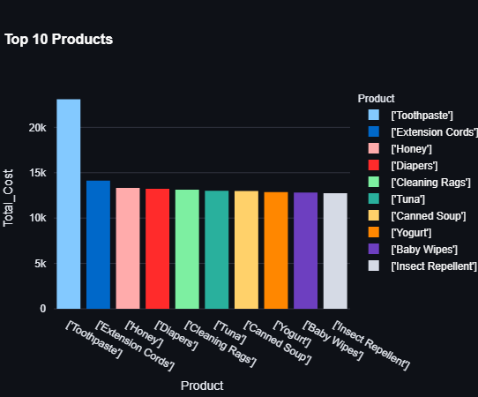
Streamlit Dashboard Insights
KPIs and Metrics:
Total Transactions, Products, Revenue, Cities, Customers.
Charts and Visuals:
Sales by City, Top Products by Revenue.
Sales by Payment Method & Store Type.
Customer Category and Seasonal Trends.
Discount Impact on Revenue.
Interactive Filters for dynamic exploration.

Slide 8
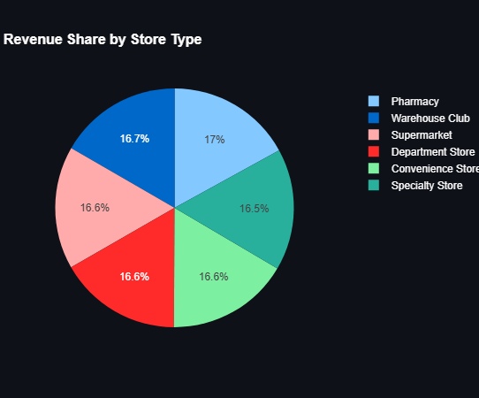
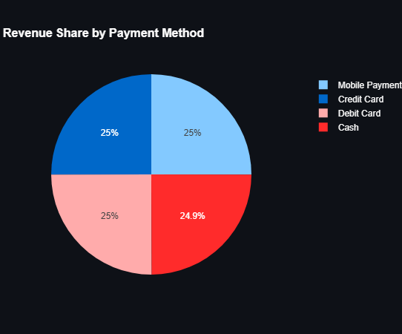

Slide 9
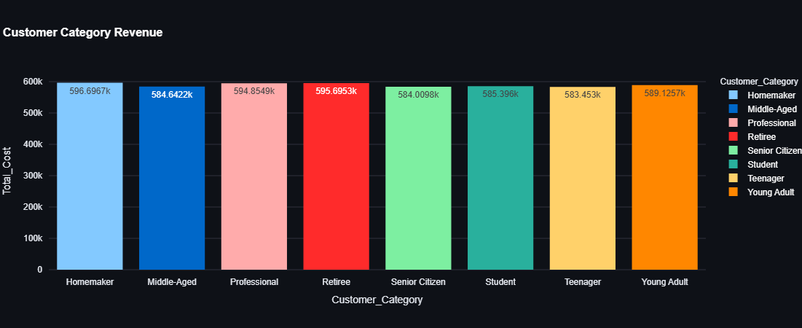

Slide 10
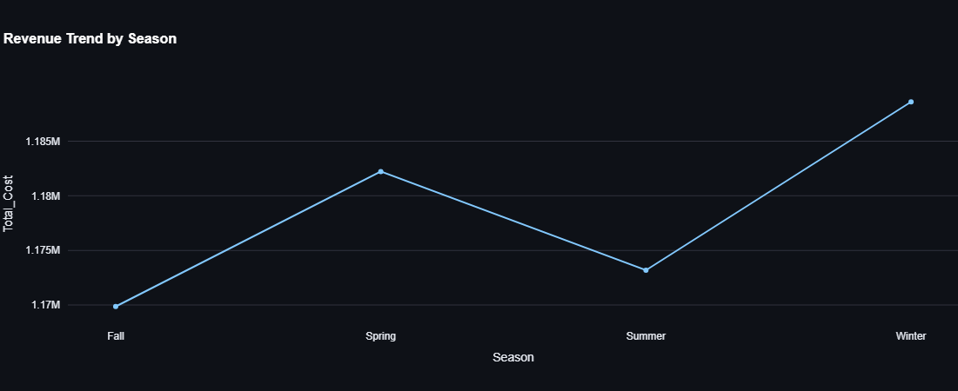

Slide 11
Business Impacts & Outcomes
Business Benefits:
Unified Retail Data Hub across multiple sources.
Automated data cleaning and transformation.
Analytical-ready datasets for faster insights.
Interactive dashboard for data-driven decisions.
Outcome: Learned full ETL lifecycle, BigQuery modeling, and dashboard analytics.

Slide 12
Thank You
Presented by:
Dandu Bhanuprakash
Project: Multi-Source Retail Data Integration Hub
Technologies: Python | BigQuery | Streamlit | Plotly
© 2025 Bhanuprakash - All Rights Reserved

